Slide 1


VoteGuard
Spotting Bullies Together
PREVENTING CYBER-BULLYING

Slide 2

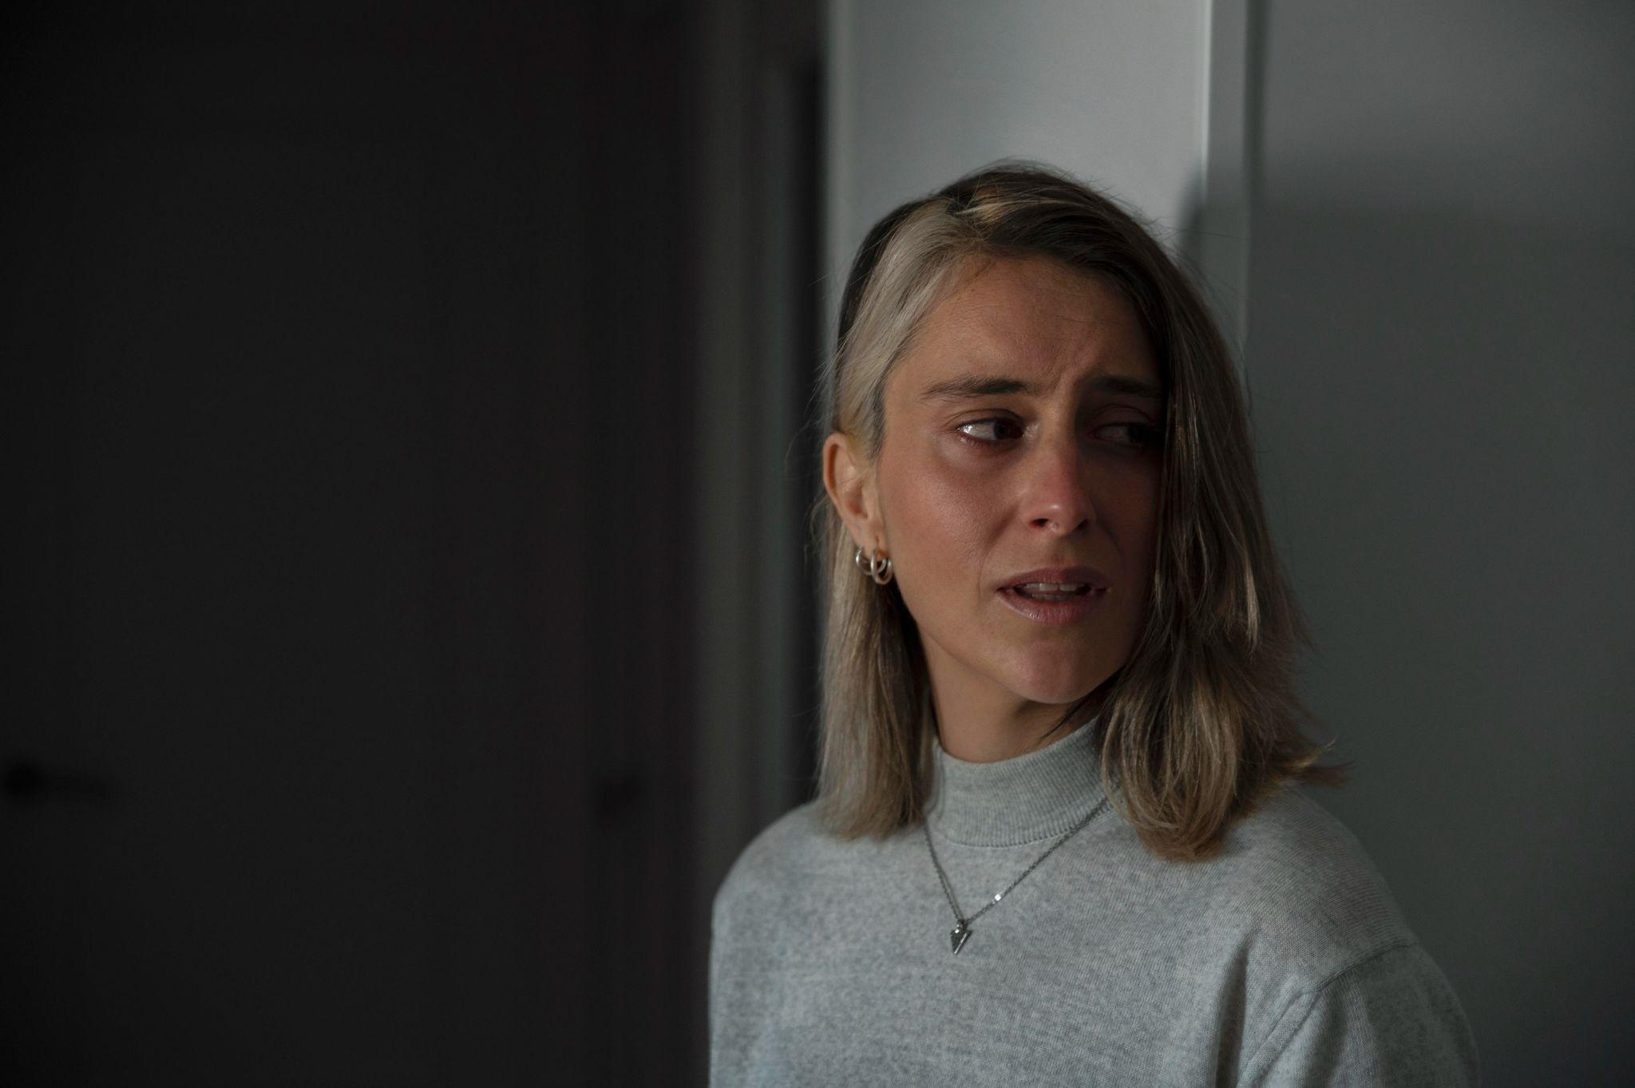
55%
More than half of high school students have faced bullying at least once in their life
PREVENTING CYBER-BULLYING

Slide 3
1 in every 20
People have faced physical bullying where they have been injured.
PREVENTING CYBER-BULLYING

Slide 4
thousands
Have committed suicide due to bullying
PREVENTING CYBER-BULLYING

Slide 5
Yet, a mere 20% of bullying cases are reported

Slide 6
Why?
Most people are afraid of reporting their bully in fear of what he/she may do to them, or he/she is to embarrassed to admit that they're being bullied

Slide 7
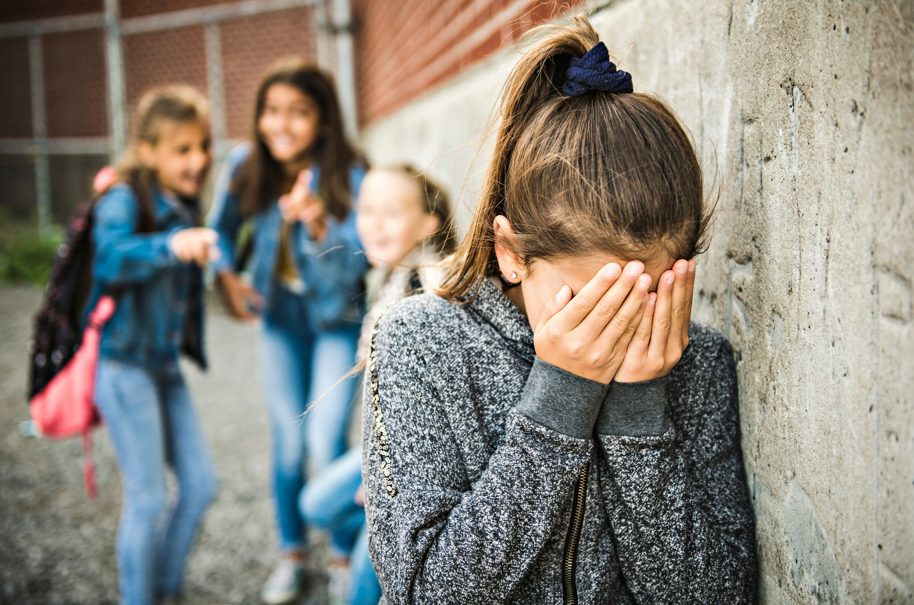
Our solution
We have created a website which allows students to report their bully completely anonymously.

Slide 8

Features of Voteguard
Keeps the identity of victim hidden.
Matter reaches school authorities.
Can attach proof in the form of either text or an image.
Bullying helpline number given.

Slide 9
With the help of this website we can encourage children to report bullying and if we can save even one life, or make even one life better, our target will be achieved.

Slide 10


